Slide 1


Human Activity Recognition with Smartphones
Authors: Aggeliki Siampli Lia Yfanti Dimitris Damtsias Manos Nikolopoulos

Slide 2

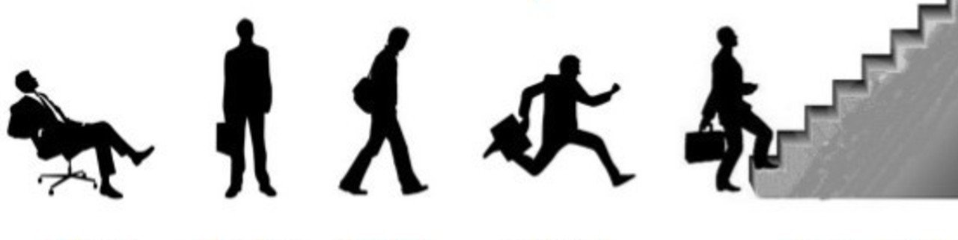

Our Mission
Our mission was to train a Neural Network that will predict/detect human activity through the daily use of smartphones that collect information via embedded inertial sensors.
sitting
standing
walking
running
climbing stairs

Slide 3
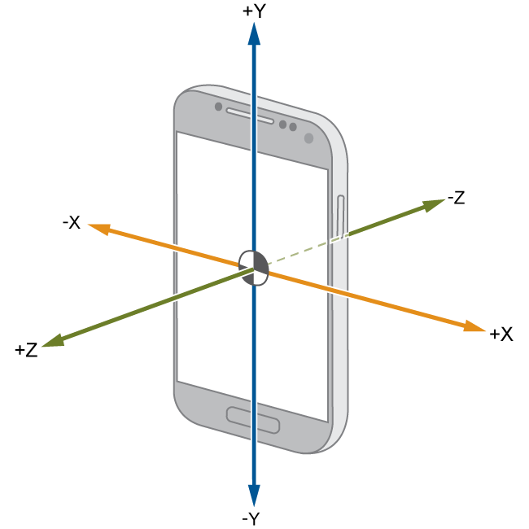
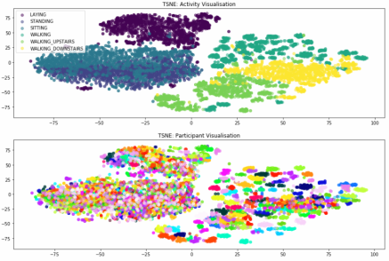
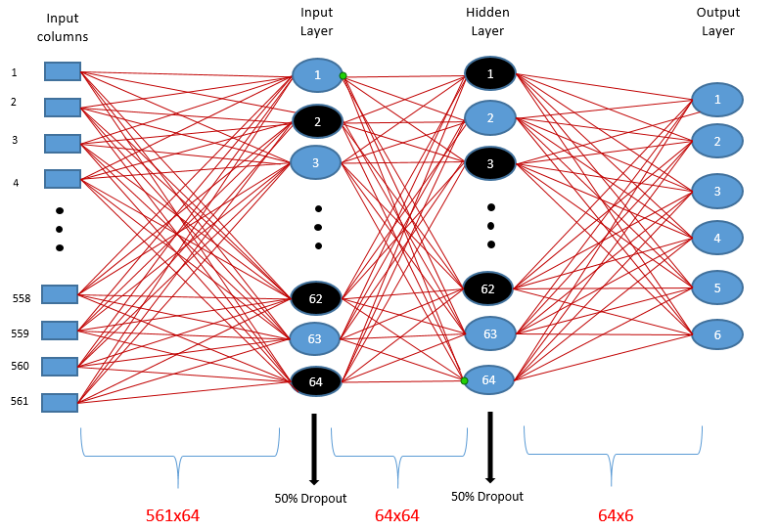
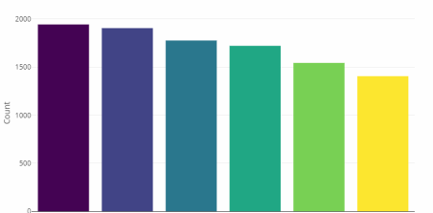
How would we accomplish that?
1
2
3
Collect Data
Analyze
Train
Collect data from users engaging in a physical activity, using a smartphone’s built in capabilities (gyroscope, speedometer, etc.)
Analyze the data to detect patterns, discrepancies and other potentially useful descriptive statistics
Use the data to train a Neural Network from the already known activities to use as a prediction model

Slide 4
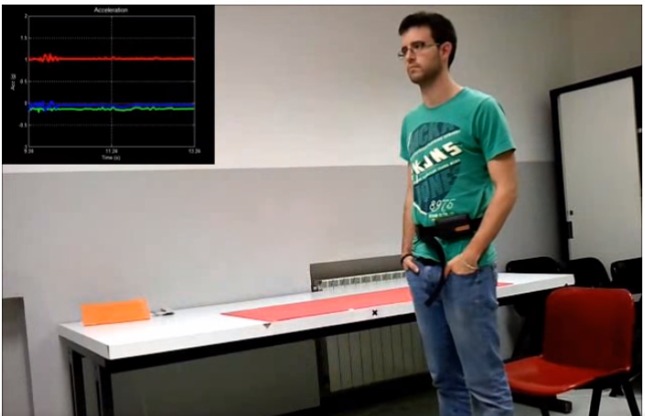
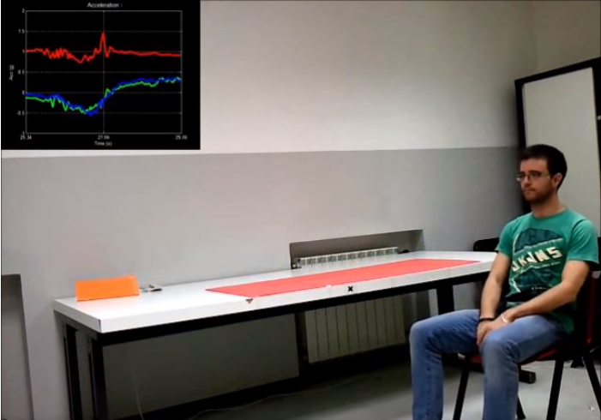
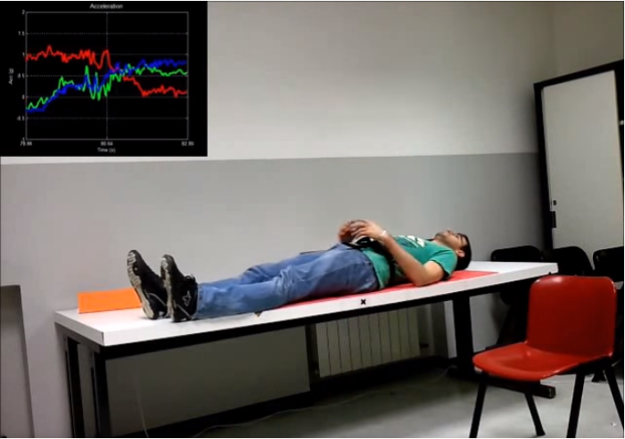
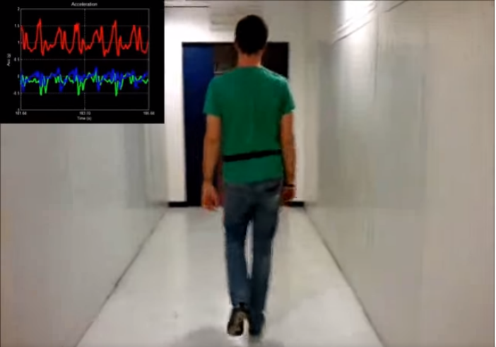
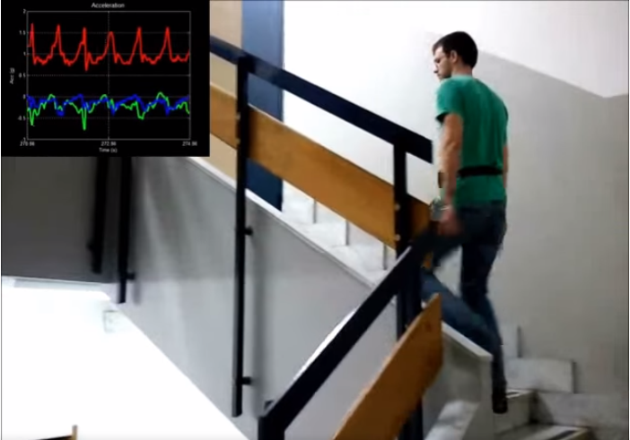
Our Data
We came across a dataset online that was built from the recordings of 30 study participants performing activities of daily living while carrying a waist-mounted smartphone

Slide 5
Our Data
The participants (ages between 19-48 years performed 6 activities:
Walking
Walking Upstairs
Walking Downstairs
Sitting
Standing
Laying
Using the phones embedded accelerometer and gyroscope, the experiments captured the 3-axial linear acceleration and 3-axial angular velocity at a constant rate of 50Hz along with a number of other metrics

Slide 6
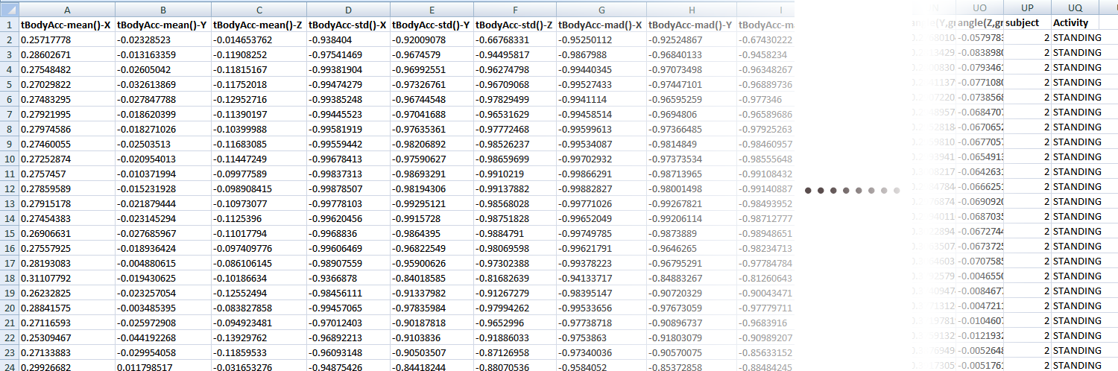
Our Data (dataset form)
10.300 records of 563 variables

Slide 7
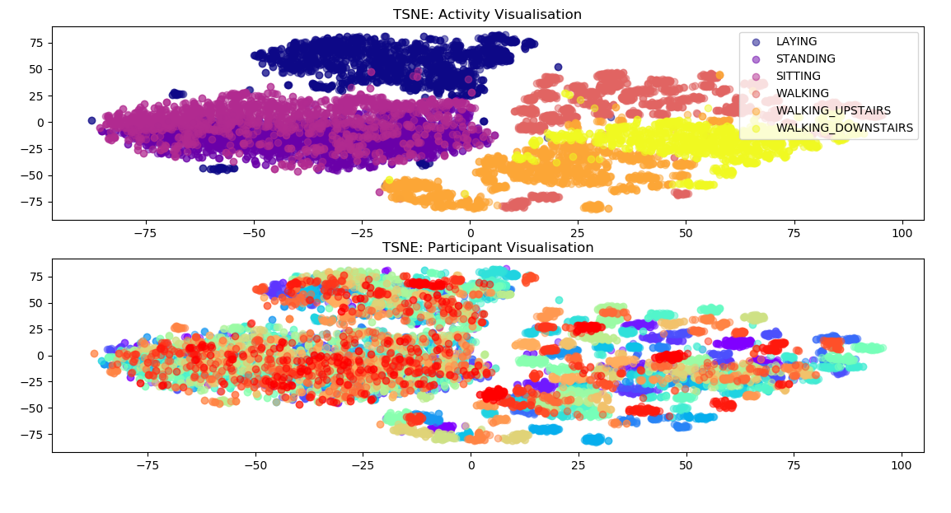
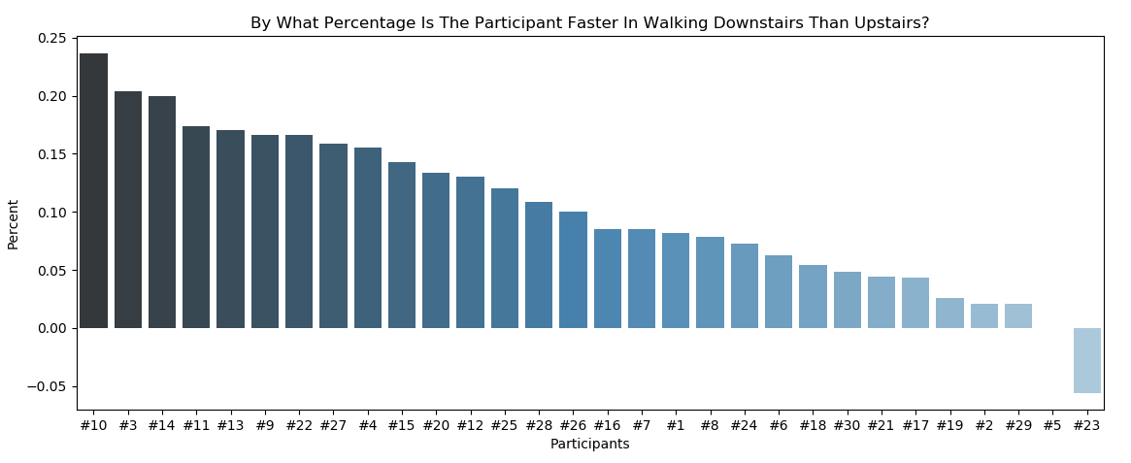
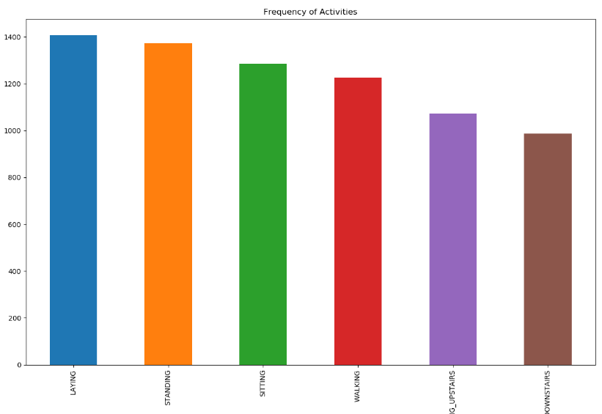
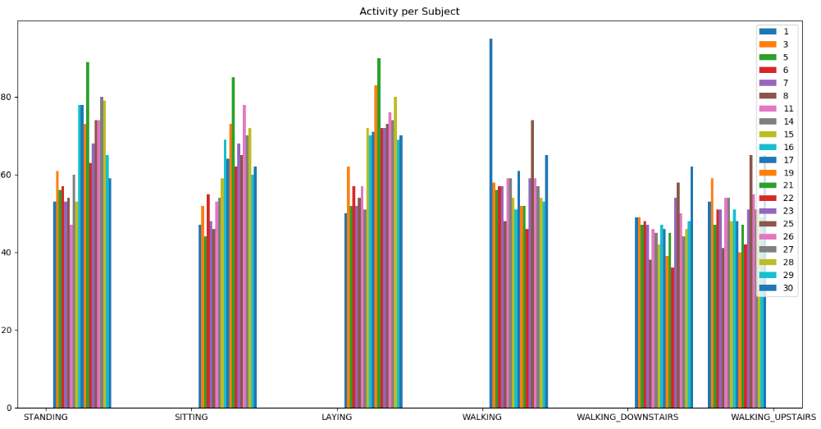
Our Data (visualize and descriptive stats)

Slide 8
Methodology
MLP – 3 Layers
One Input
One Hidden
One Output

Slide 9
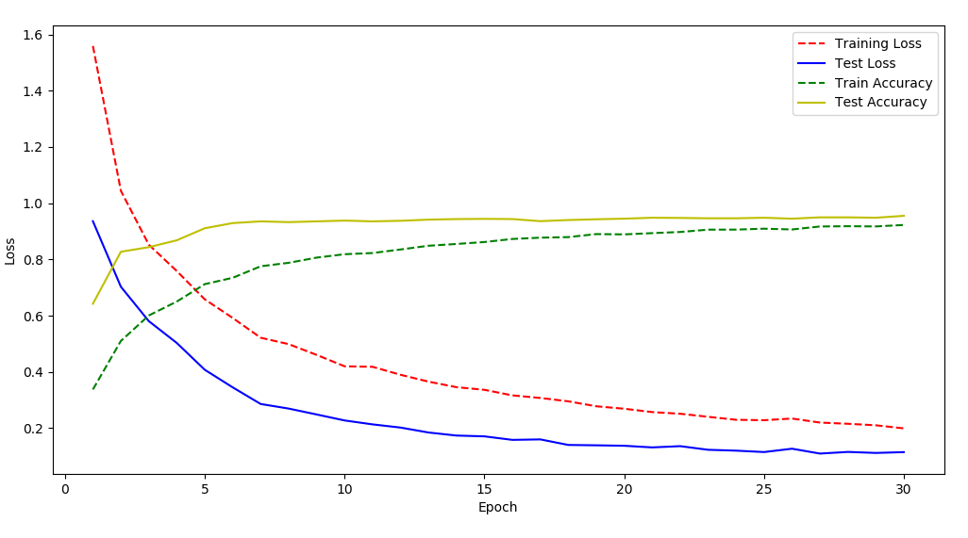
Results
96% Accuracy on train set
95% Accuracy on test set

Slide 10
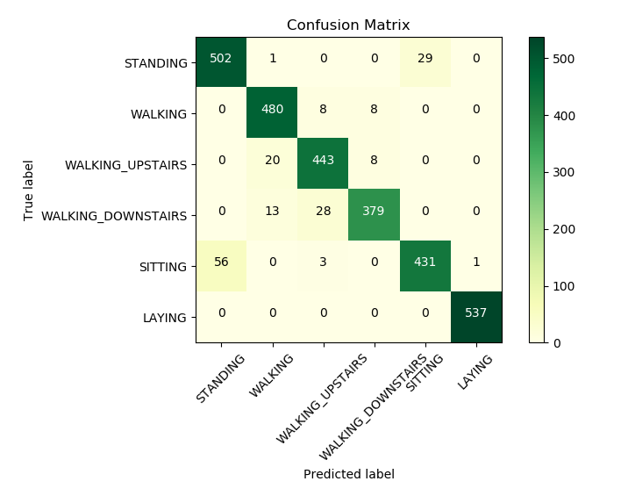
Results

Slide 11

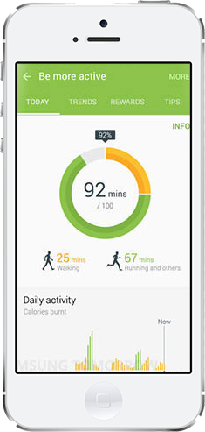
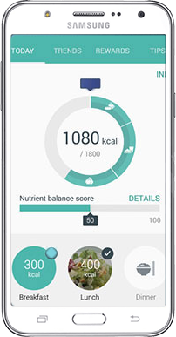


Business Applications – Healthy Living Reward Scheme

Slide 12
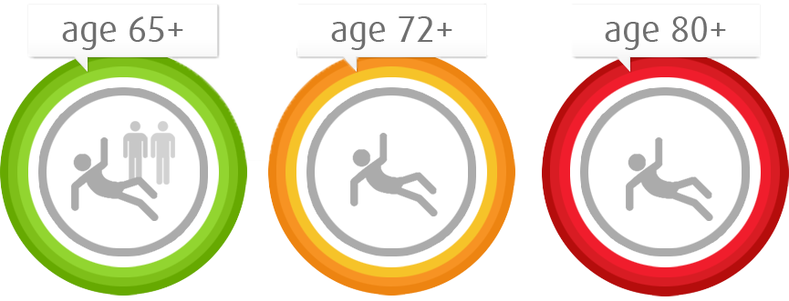
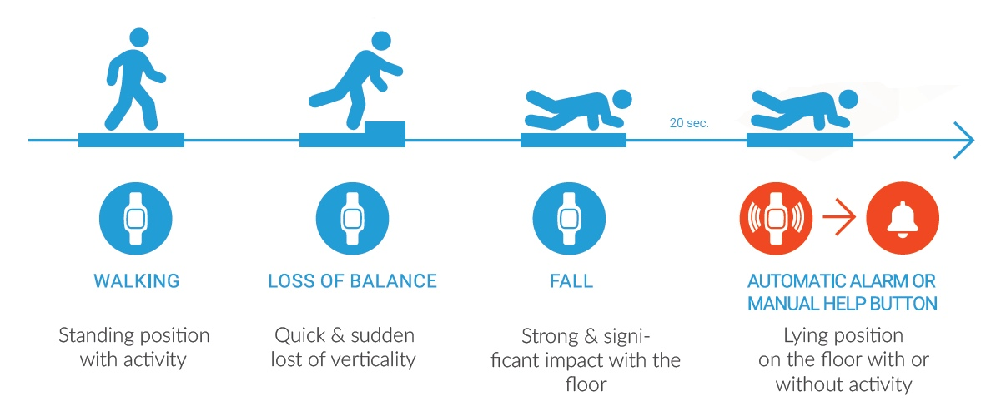
Business Applications – Next Steps – Fall detection
1 out of 3 people falls each year
Fall every two years
Fall every year

Slide 13




Our Team
Aggeliki Siampli Developer
Lia Yfanti Data Scientist
Dimitris Damtsias Data Engineer
Manos Nikolopoulos Business Analyst

Slide 14
Thank you!

